Slide 1
United Way Presentation

Slide 2
Objective
Reproduce what Vincent had done in his excel sheet in R, so United way could build a model with Forio.com
New Goal: create a Rshiny/Forio website that optimizes child well being give user inputted bounds

Slide 3
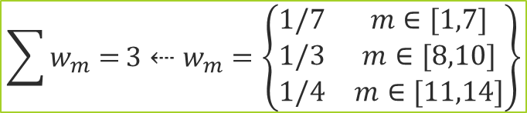
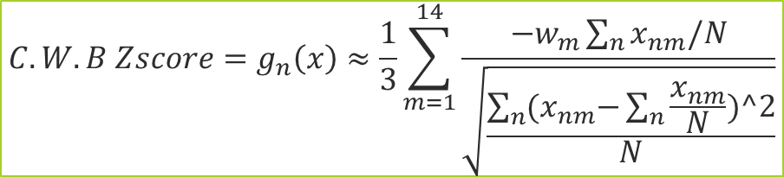
Method: Standardize
What united way wants to do when they make an index is basically standardize all the variables and do a weighted average them in a certain order.
https://en.wikipedia.org/wiki/Index_(statistics)
https://en.wikipedia.org/wiki/Human_Development_Index an example
https://en.wikipedia.org/wiki/Dow_Jones_Industrial_Average
Indexes help us rank and measure statistics
N= the total number of census tracts (rows in data) x= the actual variable data per row/column w= the weight n=row # m=column #
$$C.W.B Zscore=g_{n}\left(x\right)≈\frac{1}{3}\sum_{m=1}^{14}{\frac{−w_{m}\sum_{n}{x_{nm}/N}}{\sqrt{\frac{\sum_{n}{{(x}_{nm}−\sum_{n}{\frac{x_{nm}}{N}})^2}}{N}}}}$$
$$\sum{w_{m}=}3⇠w_{m}=\left\{\begin{matrix}1/7 & m∈[1,7] \\ 1/3 & m∈[8,10] \\ 1/4 & m∈[11,14]\end{matrix}\right\}$$
Notes:
Above is the closed form solution for Child Well being index Z-score. It is a weighted average. Each of the 3 similar weights are the 3 sub-indexes—Child Sub-index, Family Sub-index, and Community Sub-index in that order

Slide 4
Methods: Steps
Create a workable way to calculating the old Child Wellbeing Index, so we can integrate in Forio and create a visual model:
Calculate Mean and Population Deviation
Core Algorithm: Do Z-Score
Adjust it so that it is only between -3.1 and 3.1 Add the z-scores in order in listed order and divide by the amounts
Turn things that should be negative to actual negative
Calculate the Child, Family, and Community Sub-Index
CWI = Average the 3 sub indices
Rescale them from 1-100
Quintiles are calculated

Slide 5
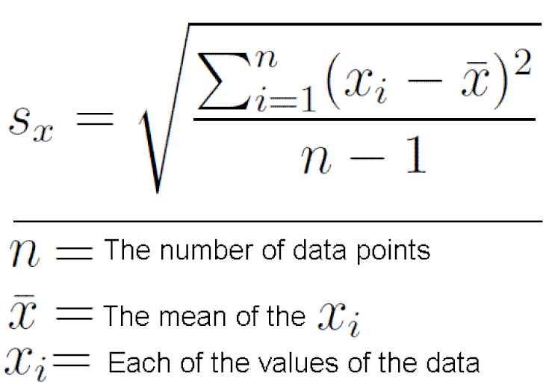
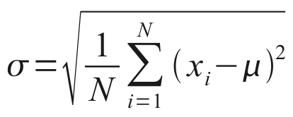

Methods: Calculate the z-score
The basic formula normally for Z-score is:
$\frac{an x−value – mean(x)}{standard deviation(x) }$ a value in x – its mean / deviation(x)
We are not using standard deviation. We are using population deviation
Standard Deviation Population Deviation
Notes:
Within these steps we need to briefly talk about a correction we had to use to Z-score

Slide 6
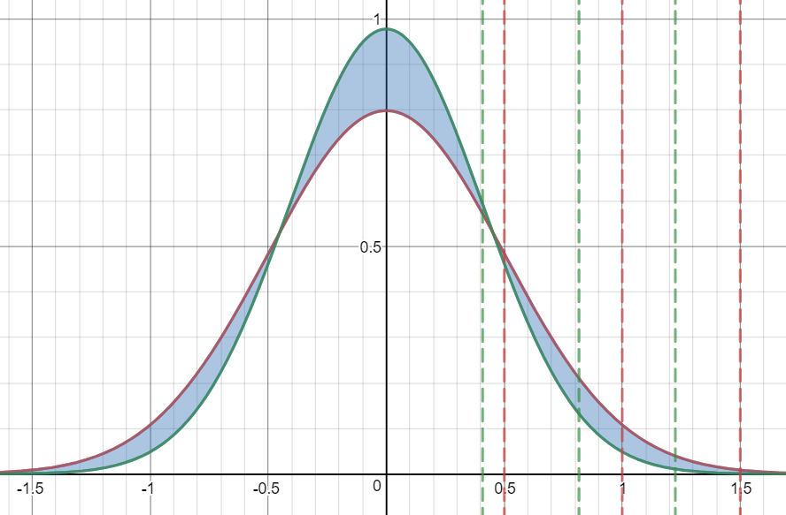


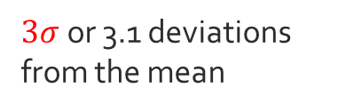


Methods: Correction Factor sample deviation VS population deviation or p:
We just need to multiply by the
$$\sqrt{\frac{n−1}{n}}$$
$$\sqrt{\frac{n−1}{n}}$$
$3σ$ or 3.1 deviations from the mean
$$σ$$
$$2σ$$
Notes:
http://stats.seandolinar.com/calculating-z-scores-with-r/
https://stackoverflow.com/questions/6263400/can-i-calculate-z-score-with-r
Or just take the equations for standard deviation and population deviation and compare them….
X = standard deviation/population deviation

Slide 7

methods
$$\sqrt{\frac{n−1}{n}}$$
Do the step but with the Correction factor:
Plots: then we plotted our results
We then created box plots, histograms, and quintiles of the Z-scores, and Indexs as we will show in our results.
We found that box plots really don’t work
Because 4 segments and quintiles are for 5
Because visually the lower end of the data is underrepresented in any separation less than 5

Slide 8
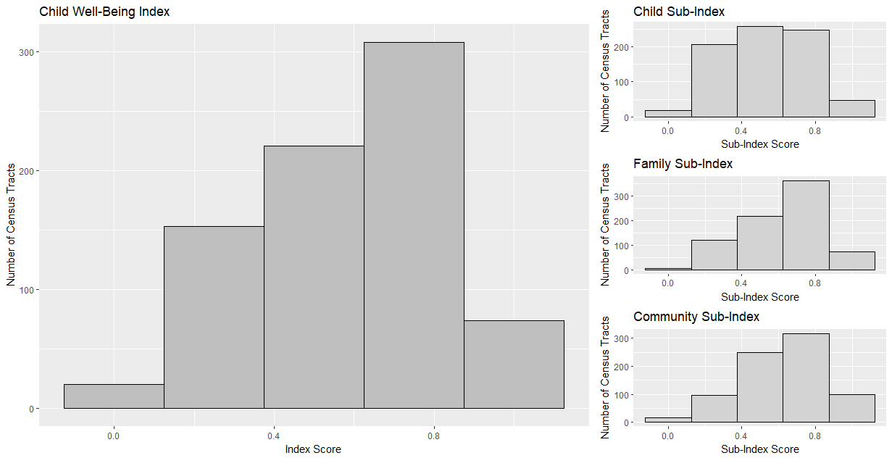
Results: Barplots

Slide 9
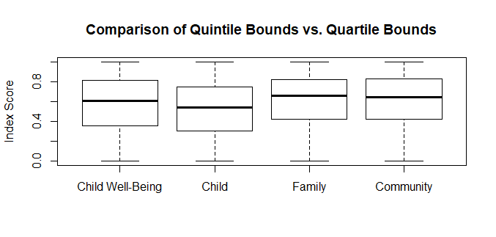
Results: Box-Plots
Notes:
These were not effective

Slide 10
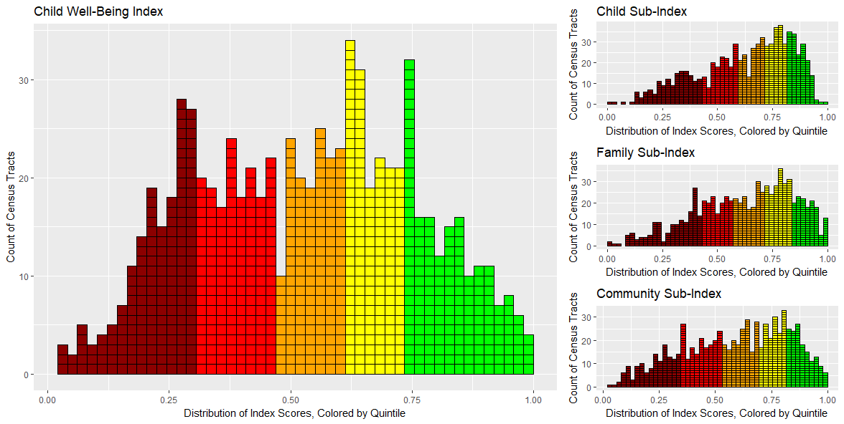
Results: Histogram Plot

Slide 11
Results: Histogram Plot

Slide 12
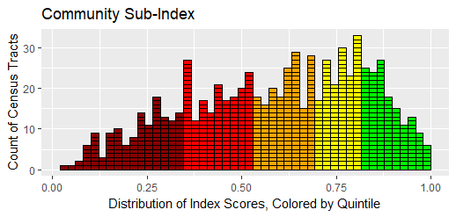
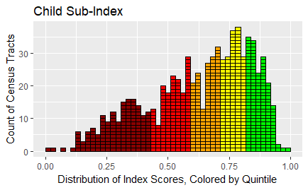
Results: SUB-indices
Community Sub-index
Child Sub-index

Slide 13
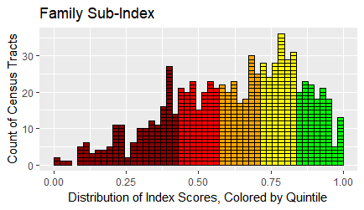
Results: SUB-indices
Community Sub-index
Family Sub-index

Slide 14
Future Exploration
In this analysis we had to correct an error how we calculated Z-scores by using population deviation instead of standard, if united way wants we
Current Deliverable: United way currently want to optimize the calculation of Child Well Being and then create a website to display that
If united way work like us to continue making the Forio app then we can. Alternatively, we can use Rshiny

Slide 15
CONTACT TO HELP WITH research
Contacts:
https://github.com/jonstoked/ChildWellBeing
https://github.com/ashtondrew/ChildhoodHunger
https://kdvdecisionanalysis.shinyapps.io/TODD_UWhunger/
Hackathon source: https://ncdata4good.github.io/UWchallenge/

